Slide 1


Michelin Starred
Restaurants Common Features Analysis
Team member：Songtao Cui
Yike Li
Kunzhi Wang
Jinze Li

Slide 2


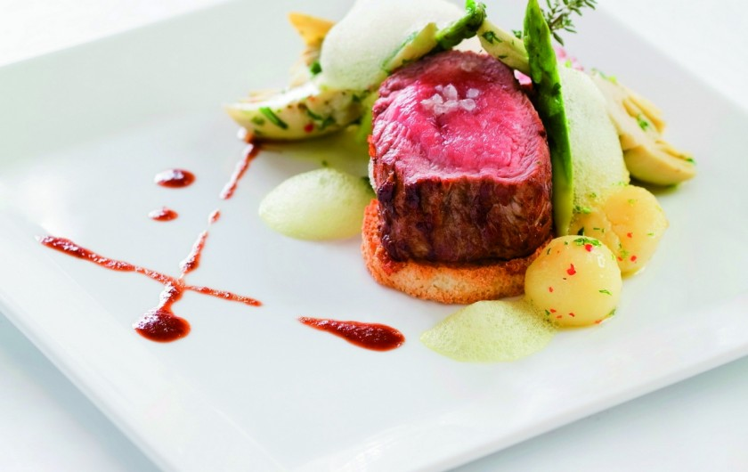
Hypotheses
H1
Flavor of food, environment&service, food variety are major aspects for restaurant ranking.
H2
Sentimental scores of the comments of the users indicate that the diners agree with the Michelin Guides official point of views.

Slide 3
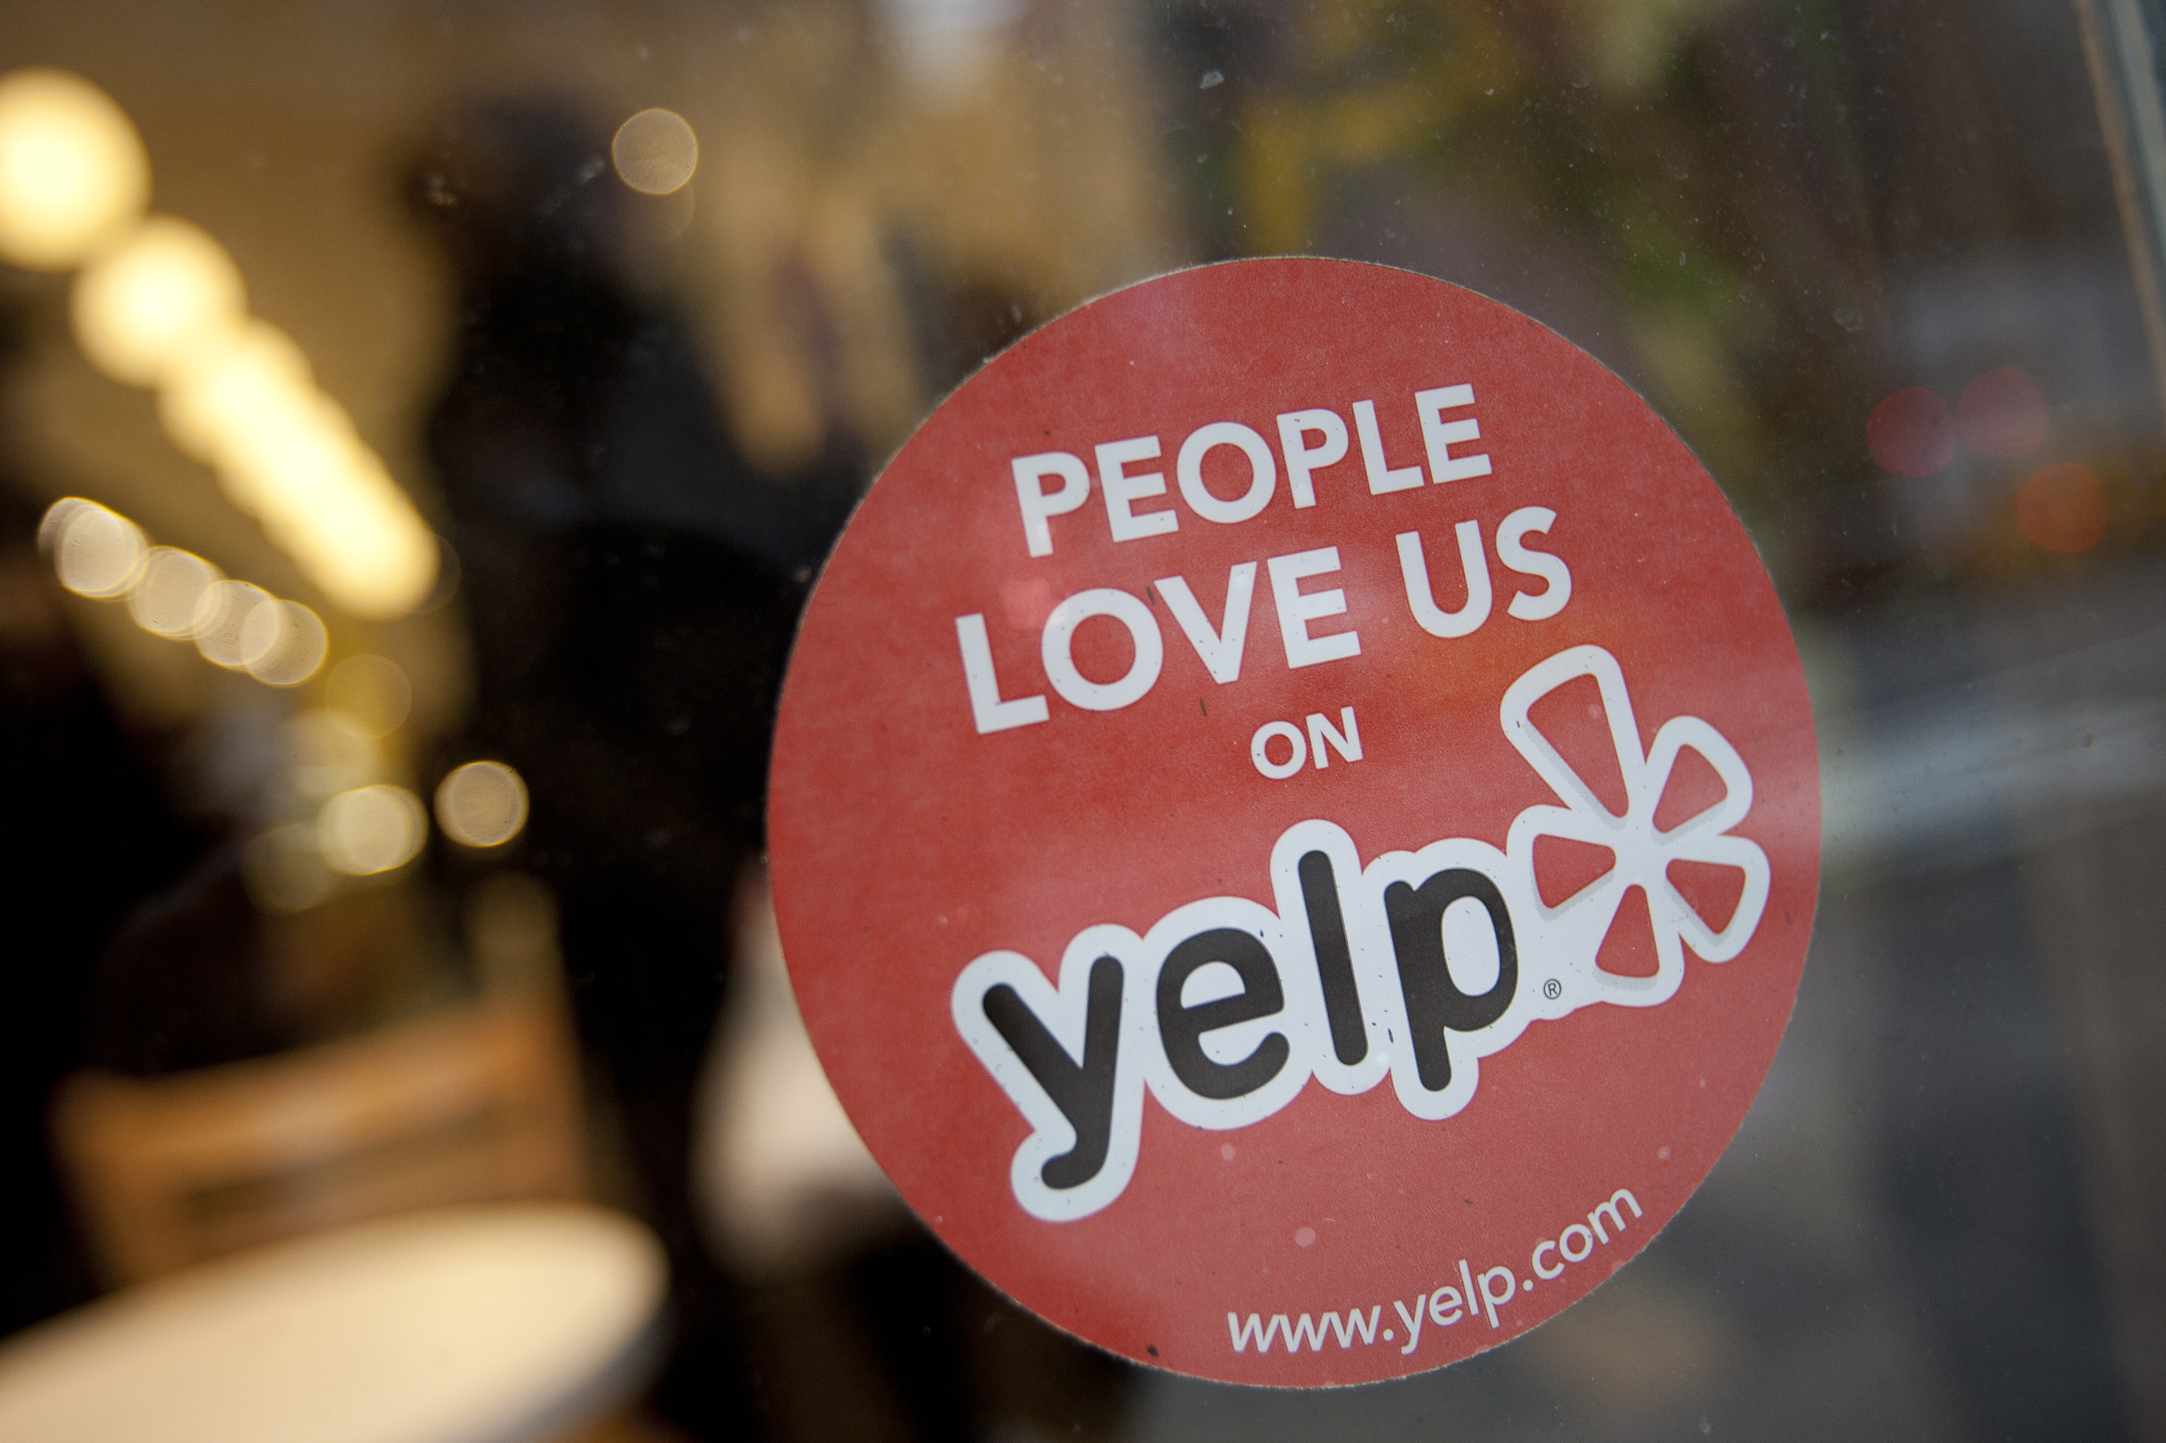
Data Collection & Description
Source: Yelp--Review
Format: Csv file
Size: 30 Michelin starred restaurants
32427 reviews
Method: Python Beautifulsoup package
Attributes: review text; author; datePublished; ratingstar
Data cleaning: remove stopwords, tokenize

Slide 4
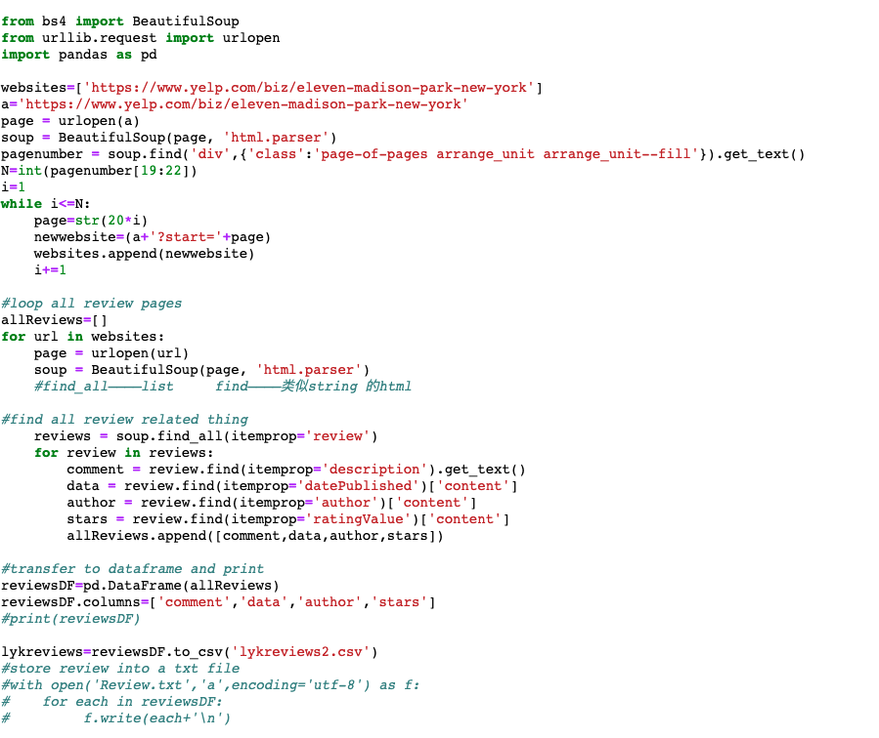
Data Collection & Description

Slide 5
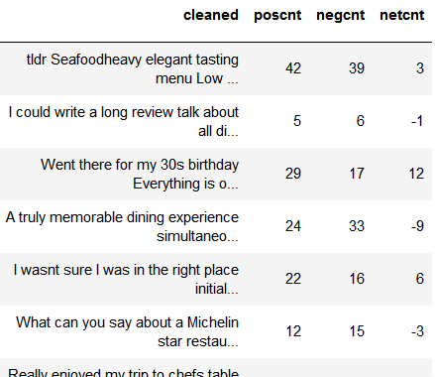
Sentiment Analysis
Sentiment Analysis with Python
Sentiment Analysis
Scores
Evaluation

Slide 6
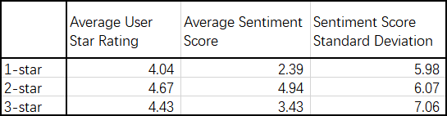
Sentiment Analysis
Sentiment scores
User star ratings
Michelin Stars
Sentiment Analysis
Scores
Evaluation

Slide 7
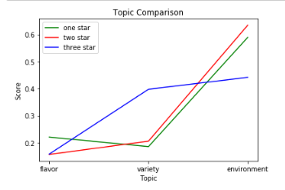
Topic Modeling
Topic Modeling
with Gensim
Topic Modeling
Scores
Evaluation
Notes:
Customers in one-star, two-star and three-star restaurants are mainly talking about environment.

Slide 8
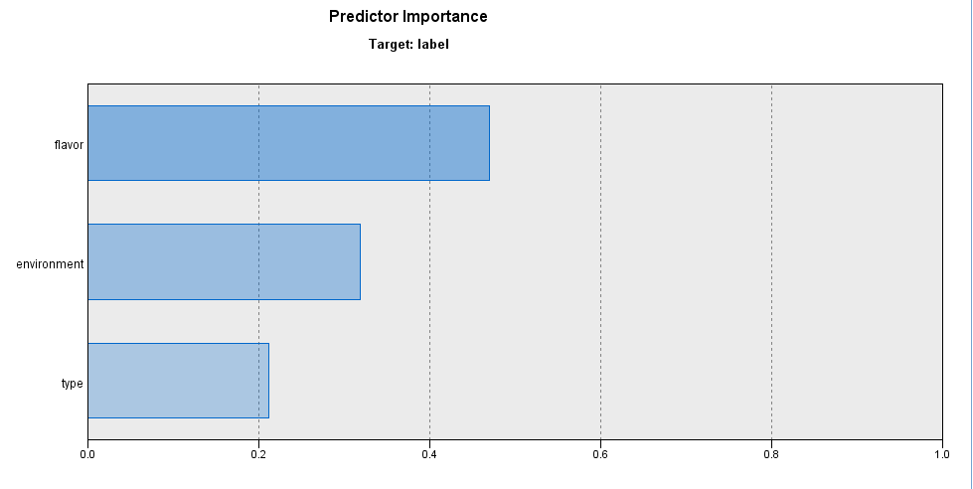
Topic Modeling
Topic Modeling
Scores
Evaluation
Notes:
It reveals that topic flavor plays a more significant role in determining which level one restaurant is.

Slide 9
Concept Model
Linear Regression
Random Forest model
Prepared Data
Text Mining in SPSS modeler
Top 75 Concepts
Neural network model

Slide 10
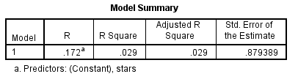
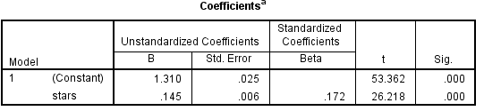
Linear regression
$$Michelin star=0.1449∗marks+1.31$$

Slide 11
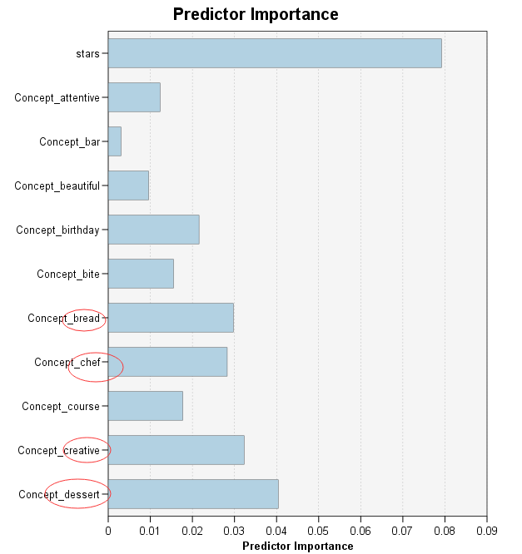
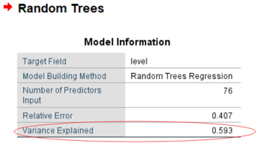
Random forest model

Slide 12
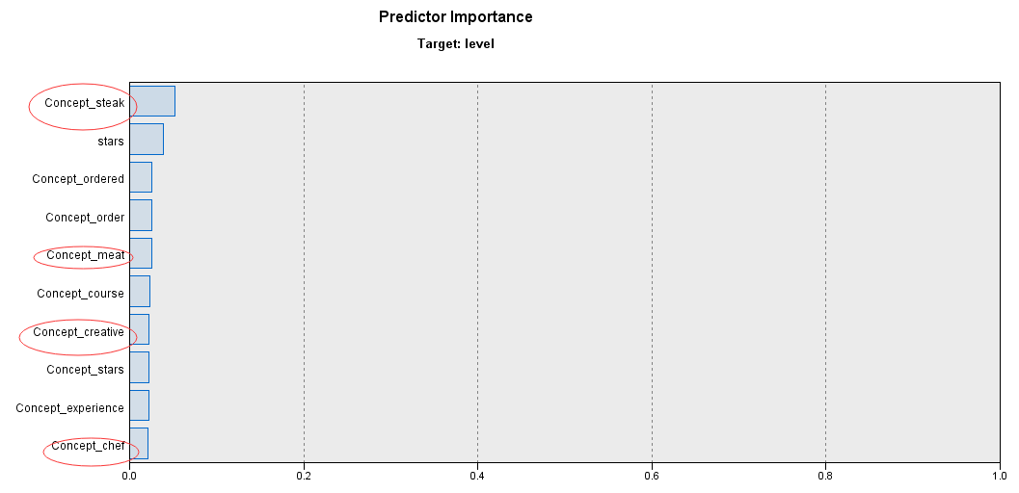
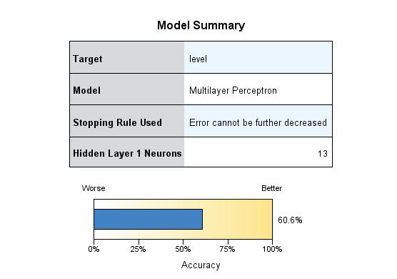
Neural Network Model

Slide 13


Conclusion
Michelin 3-star restaurants do not always get the highest sentiment and user star ratings.
Creativity and the courses are important factors for Michelin star ratings.
All customers likes to focus on environments.

Slide 14

Recommendation
Focus on improving the dining environment and service
Value the customers’ review and make adjustment properly
Besides the main dish, add importance to others on the menu

Slide 15

Project Timeline
3/9/2019
3/20/2019
4/1/2019
4/24/2019
10%
25%
75%
100%
Data Collection
Data Processing
Model Building
Result & Evaluation
Browse datasets in interested domain and crawl datasets
Design Proposal
Clean data: remove stopword
Tokenization
Sentiment analysis
Topic Modeling
Combination model
Provide Recommendations to improve star level
Prepare presentation and project report

Slide 16

Thank You!
Q&A

